Slide 1
Chapter 14: Key Management and Distribution
Freshman Seminar
2022.02.08
Sumin Sohn

Slide 2
Contents
14.1 Symmetric key distribution using symmetric encryption
14.2 Symmetric key distribution using asymmetric encryption
14.3 Distribution of public keys
14.4 X.509 certificates
14.5 Public key infrastructure

Slide 3
14.1 Symmetric key distribution using symmetric encryption

Slide 4
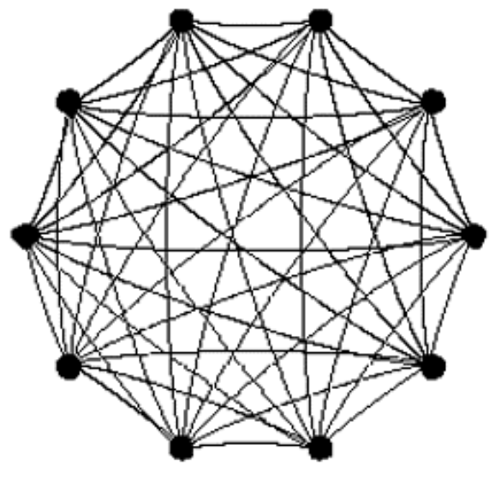
Physical Delivery of Key
Two parties must share the same key
Sender can select a key and physically deliver it to receiver
Third party can select a key and physically deliver it to sender and receiver
Physical delivery is awkward for End-to-end encryption over a network
Network needs a number of keys that is connected to all participants on network

Slide 5
Remote Delivery of Key
If sender and receiver already shared key, new key can be shared after encrypted using the old key
If attacker gained access to one key, all subsequent keys will be revealed
Third party deliver a key on the encrypted links to sender and receiver
Session key is used to communication between end systems
Master key is used to communication between end system and trusted third party, in other words, key distribution center
The required number of keys is reduced

Slide 6
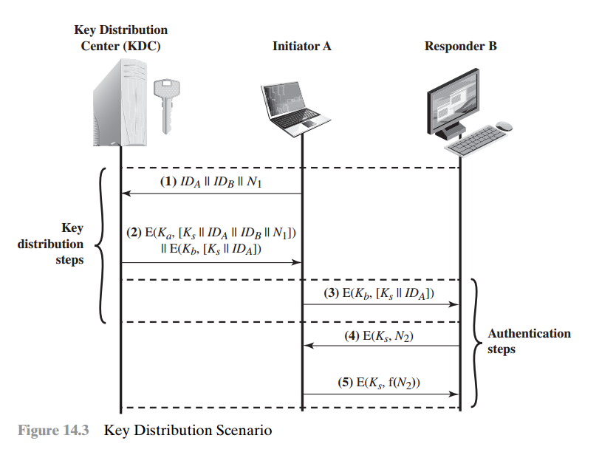
A key Distribution Scenario #1
Unique master key with KDC is already shared
A wants to establish a secure connection with B
A requests to KDC for a session key
The message includes identity of A and B
Nonce is the representative of this transaction
The KDC responds with a message encrypted with master key with A
Session key and original request message is included to enable A to match with the appropriate request

Slide 7
A Key Distribution Scenario #2
In addition, the message includes session key and an identifier of A which can be verified by only B
A send the above message
A and B shared session key
B send the message of nonce encrypted session key
A respond the message of processed nonce encrypted with session key
Prevent the attack that the attacker pretend user A

Slide 8
Hierarchical Key Control
A hierarchy of KDC can be established
Local KDC is in charge of local domain
Global KDC is in charge of connecting the two different local domains
Limits the damage of subverted KDC to its local area only

Slide 9
Session Key Lifetime
The more frequently session keys are exchanged, The more secure they are
There is distribution of session keys delays
Connection oriented protocol
Use the different session key on each connections
Connectionless protocol
Use session key for a fixed period or for a certain number of transactions

Slide 10
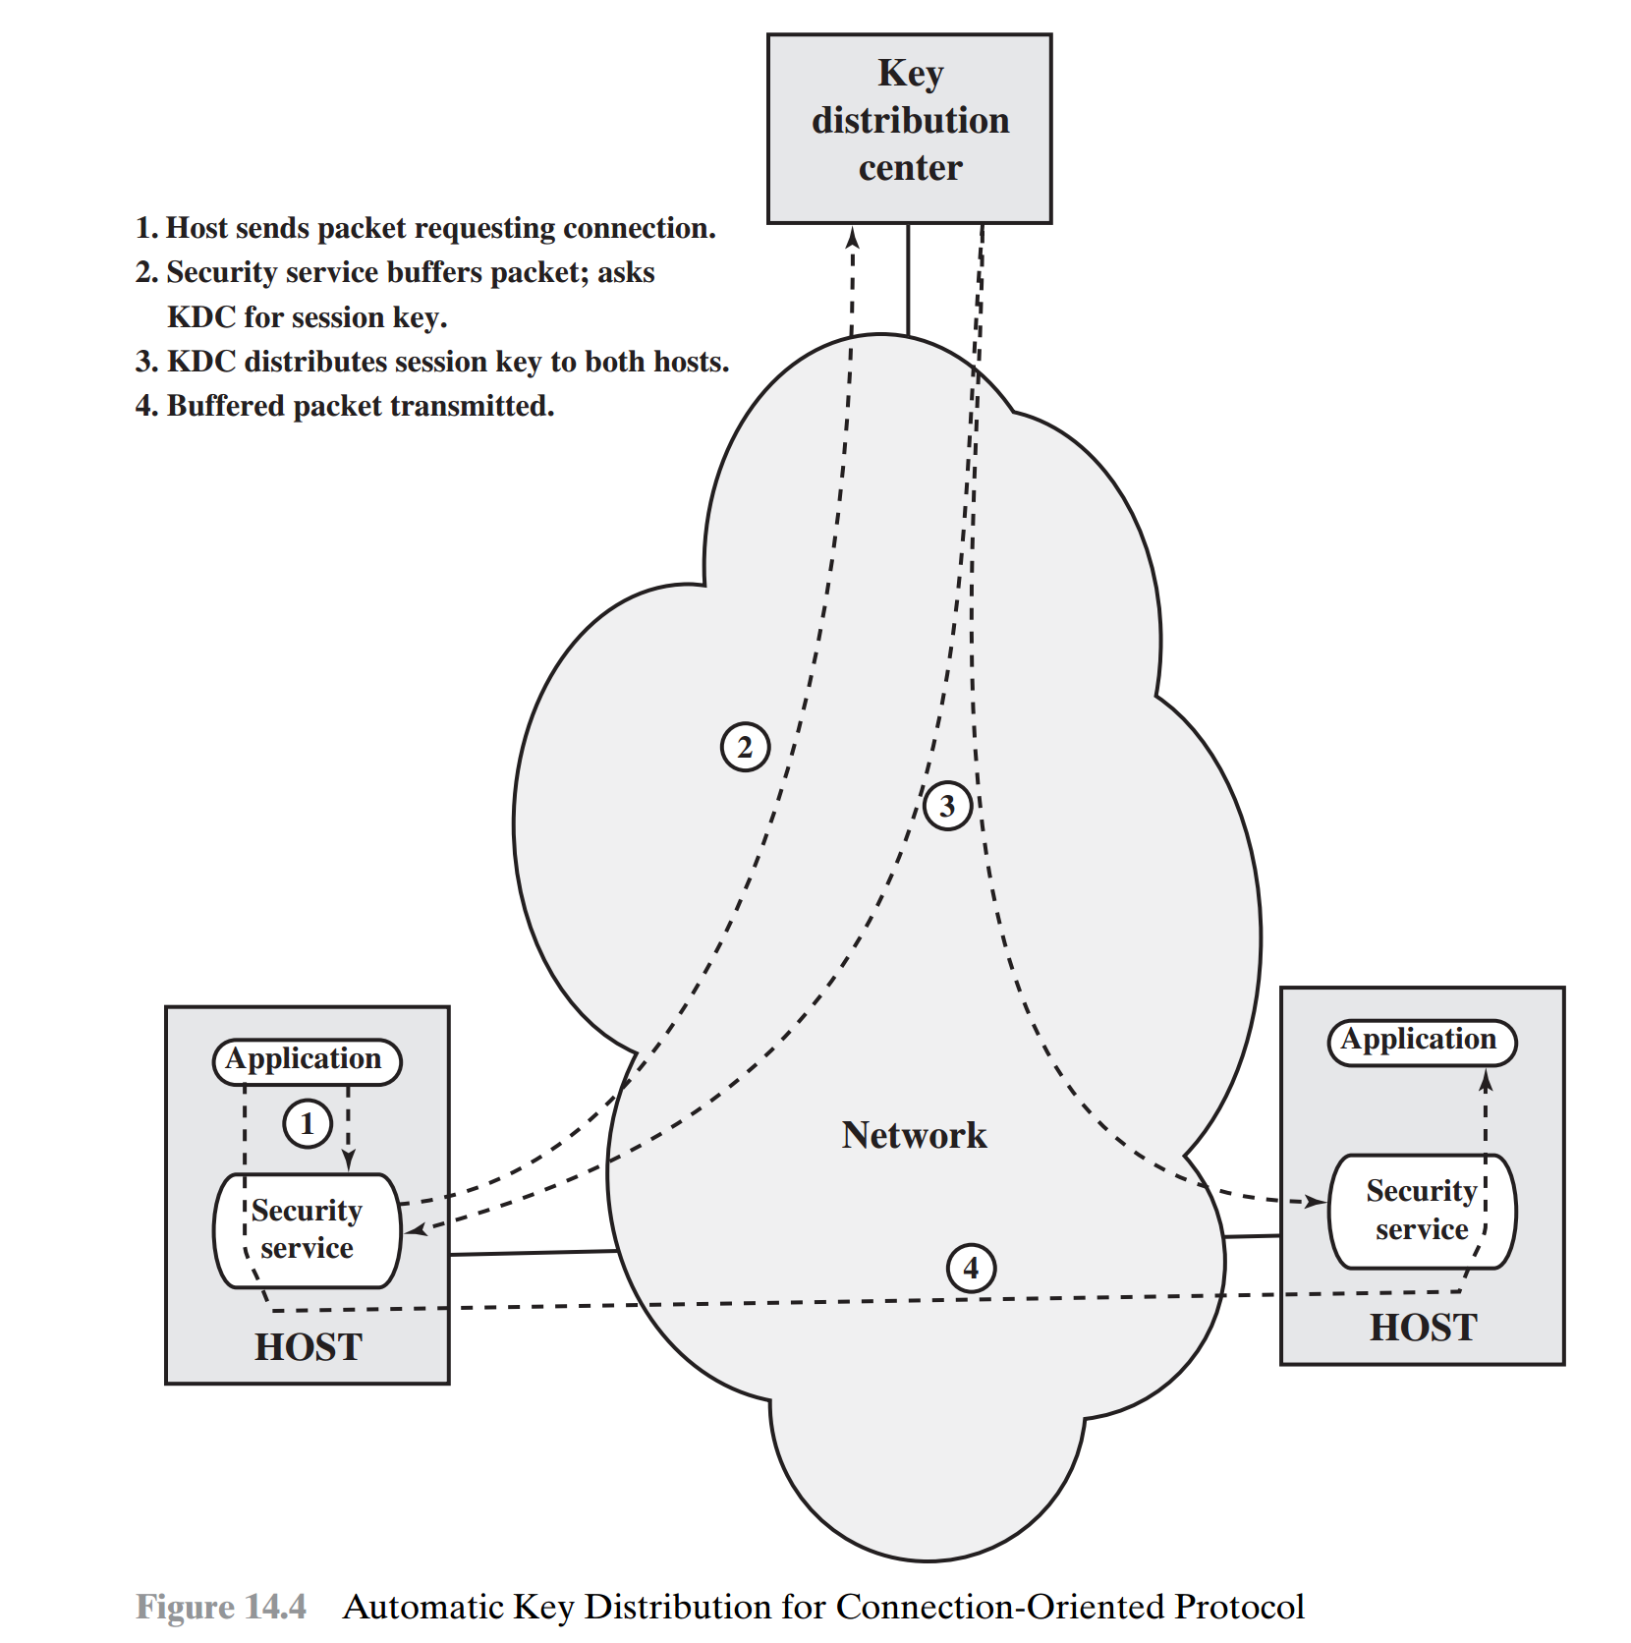
A Transparent Key Control Scheme
Session security module(SSM) is in charge of making secure end-to-end communication
One host wants to set up a connection to another host
SSM get the session key from the KDC
After getting session key, SSM releases connection request packet to another host

Slide 11
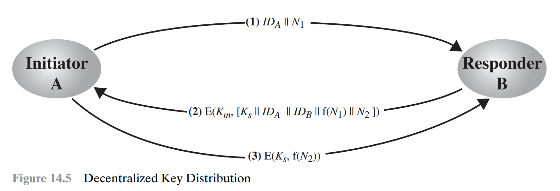
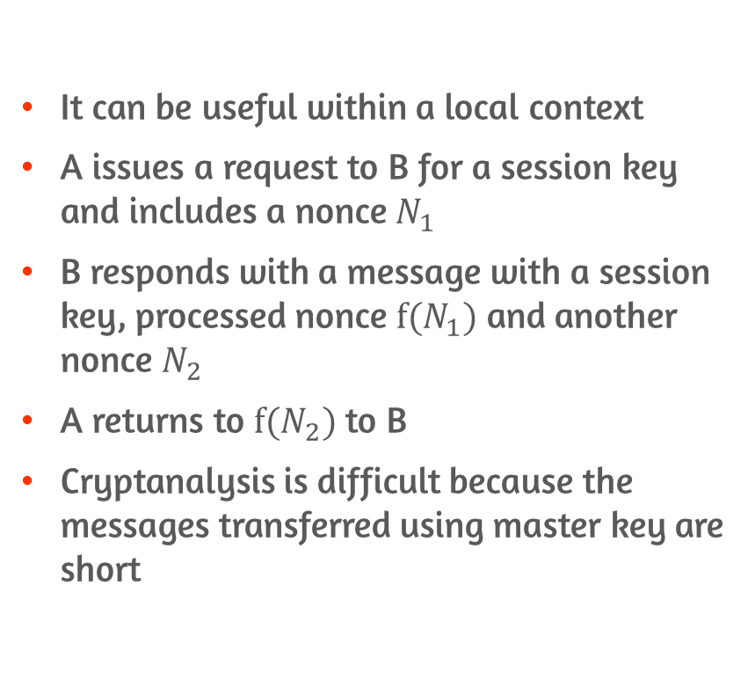
Decentralized Key Control
It can be useful within a local context
A issues a request to B for a session key and includes a nonce $N_{1}$
B responds with a message with a session key, processed nonce $f(N_{1})$ and another nonce $N_{2}$
A returns to $f(N_{2})$ to B
Cryptanalysis is difficult because the messages transferred using master key are short

Slide 12
Controlling Key Usage
Define different types of session keys
Associate a tag with each key
8 bits tag limits flexibility
Can not be used before decryption because (key+tag)is encrypted with master key
Control vector
No restriction on length
Can be used before decryption because encrypted session key and control vector are separately provided

Slide 13
14.2 Symmetric key distribution using asymmetric encryption

Slide 14
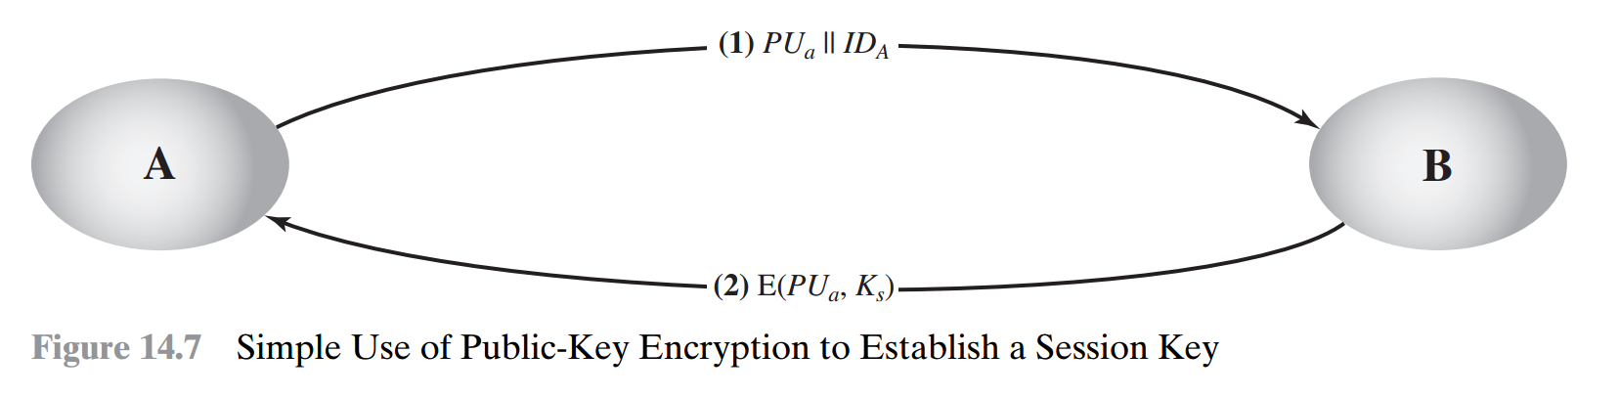
Simple Secret Key Distribution
Due to the inefficiency of the public key cryptosystems, they are used for key distribution
A generates public/private key pair
A send public key and an identifier of A
B generates session key
B send encrypted session key using A’s public key
All the other key except session key is discarded

Slide 15
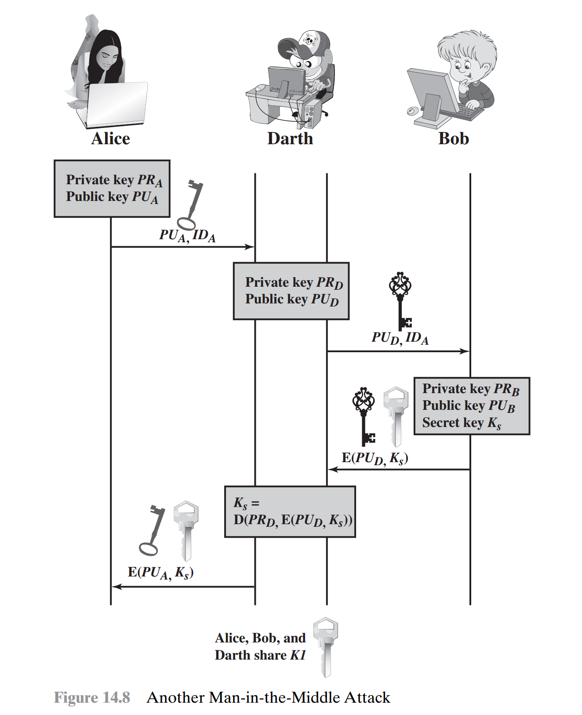
Possible Attack on Simple Key Distribution
D generates public/private key pair
D intercepts the message sent by A
D replace A’s public key with D’s public key and send it to B
B generates session key encrypted with D’s public key
D knows about session key and send session key encrypted using A’s public key
Now D can snoop all of the transactions between A and B

Slide 16
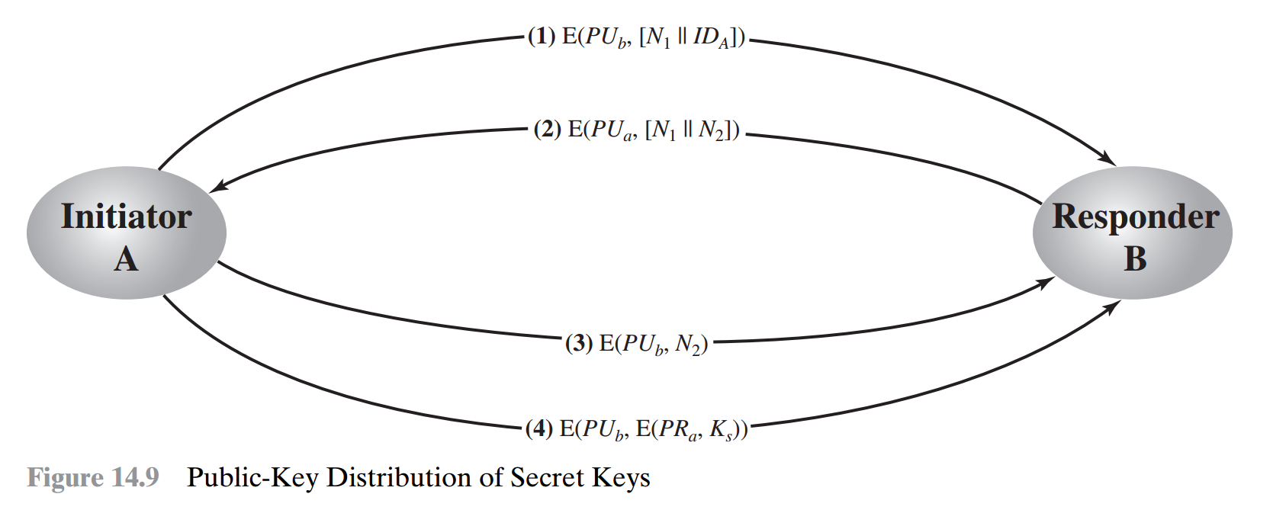
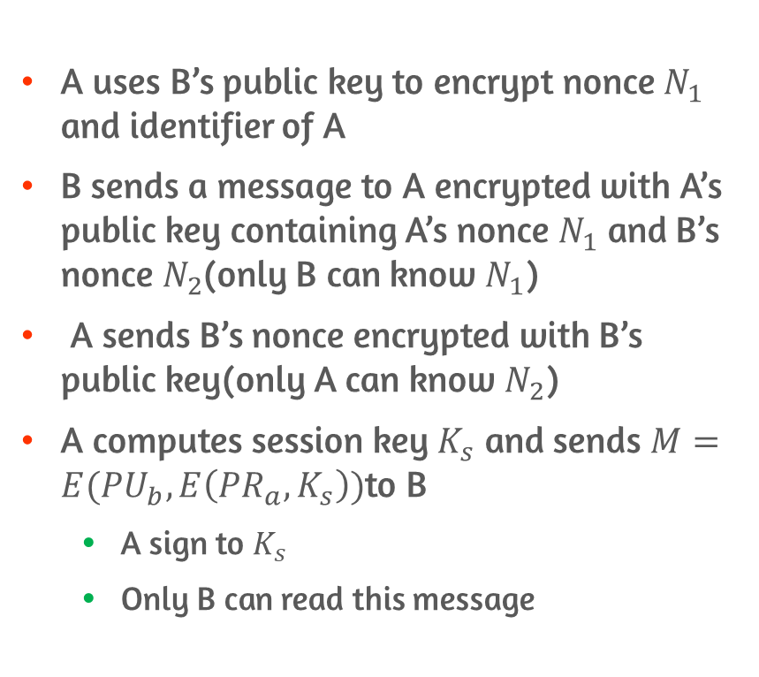
Advanced Secret Key Distribution
A uses B’s public key to encrypt nonce $N_{1}$ and identifier of A
B sends a message to A encrypted with A’s public key containing A’s nonce $N_{1}$ and B’s nonce $N_{2}$(only B can know $N_{1}$)
A sends B’s nonce encrypted with B’s public key(only A can know $N_{2}$)
A computes session key $K_{s}$ and sends $M=E({PU}_{b},E\left({PR}_{a},K_{s}\right))$to B
A sign to $K_{s}$
Only B can read this message

Slide 17
14.3 Distribution of public keys

Slide 18
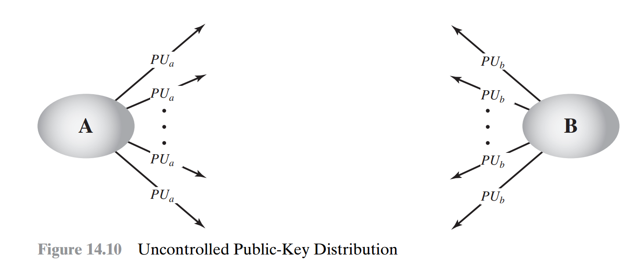
Public Announcement
Broadcast the public key to the community at large
Anyone can forge public announcement
Attacker can pretend to user A

Slide 19
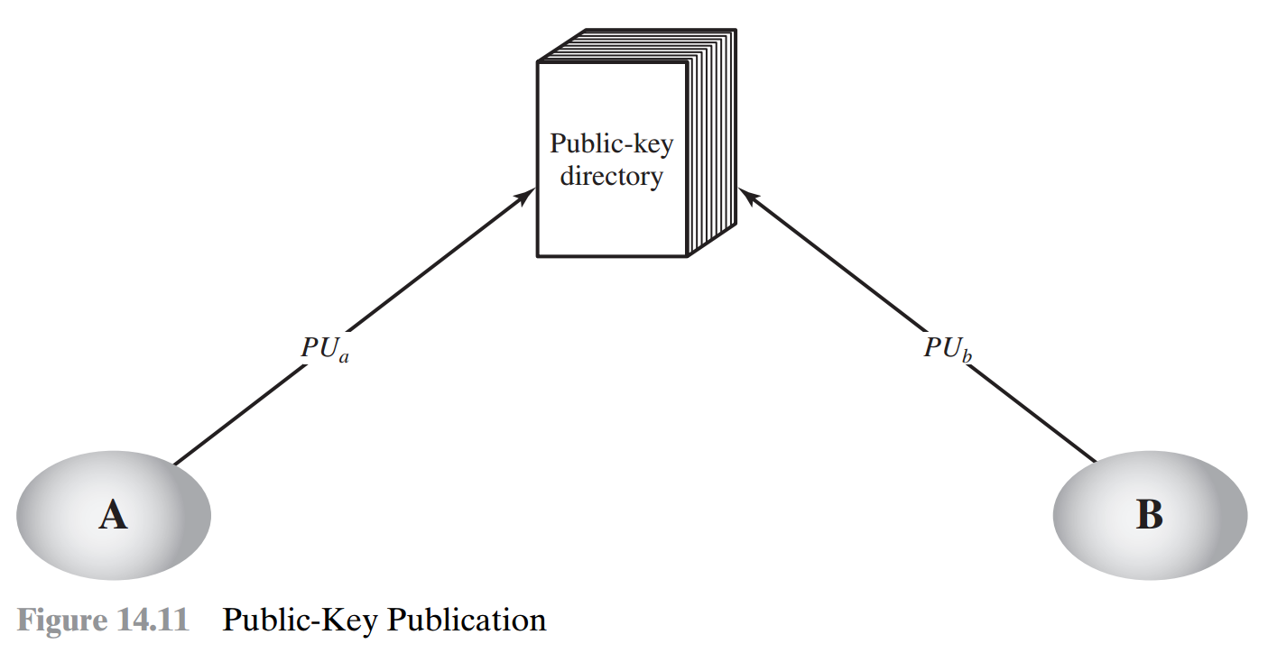
Publicly Available Directory
Trusted third party maintains public key directory
Each user can obtain public key from directory
Has vulnerabilities
Attacker could tamper with the records kept by authority after getting the private key of authority

Slide 20
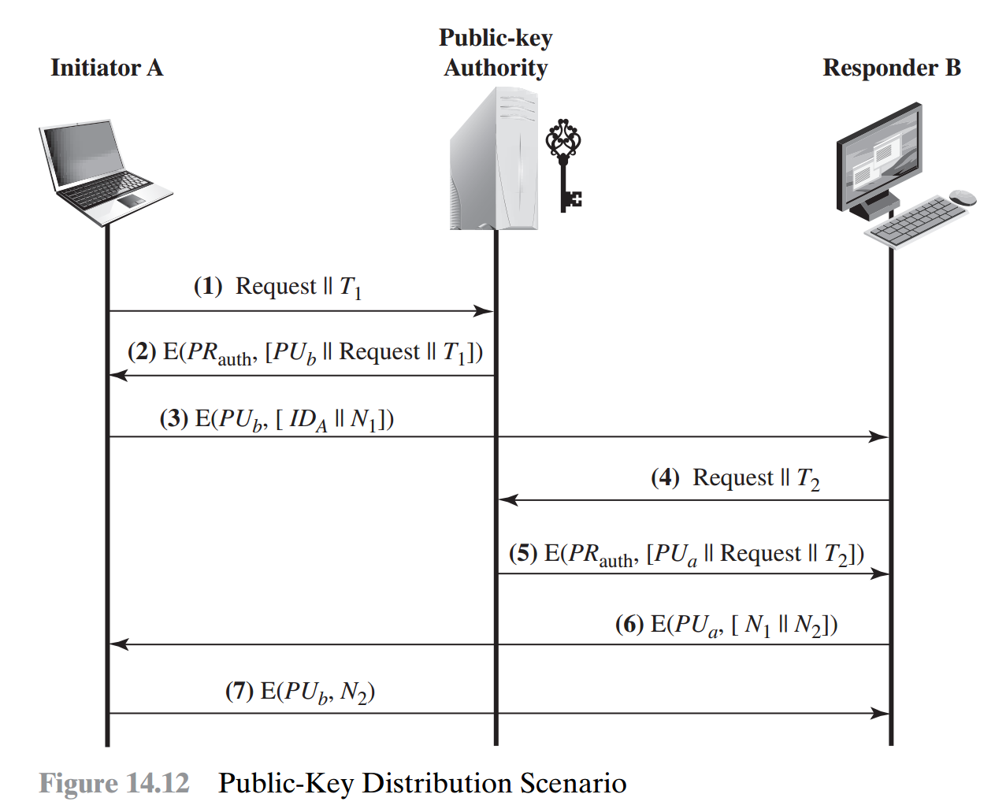
Public-key Authority
Strong control over public key directory
Each user knows a public key for the authority
A knows that message is valid by decrypting the message with authority’s public key
By exchanging nonces, A and B authenticate each other

Slide 21
Public Key Certificate
Public key authority system can be bottleneck in the system
Vulnerable to tampering
Can be used by participants to exchange keys without contacting authority
Signed by certificate authority
Requirements
Any participant can read a certificate
Any participant can verify a certificate
Only the certificate authority(CA) can create certificate
Any participant can verify the time validity of the certificate

Slide 22
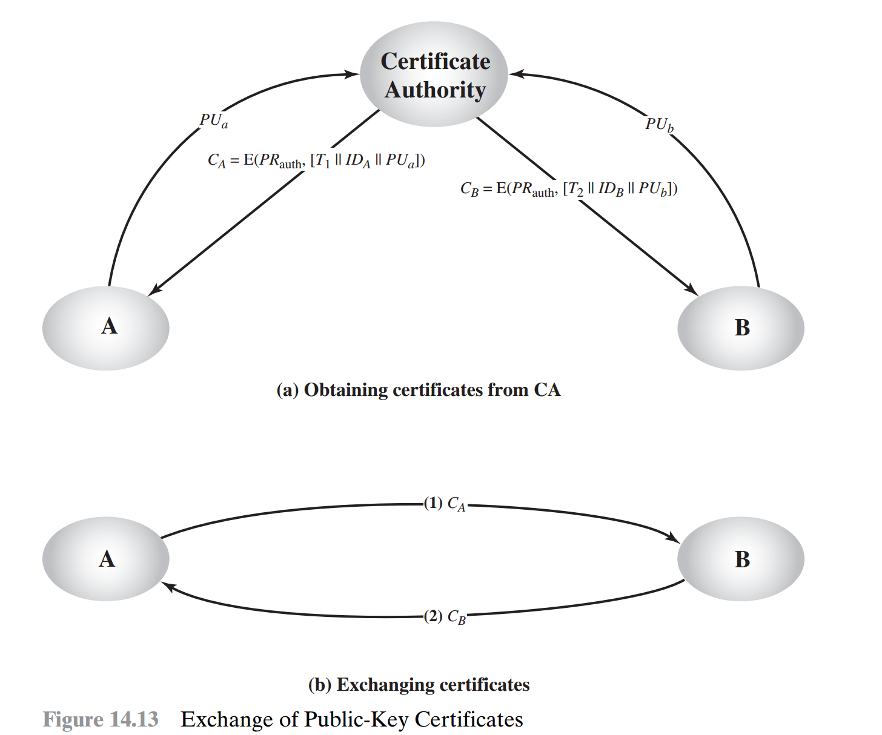
Example of Public-key Certificate
Time stamp , identifier of user and public key of user is encrypted with CA’s private key
Time stamp indicates expiration date
Verify certificate with CA’s public key
By exchanging certificate, each user can securely share public key

Slide 23
14.4 X.509 certificates

Slide 24
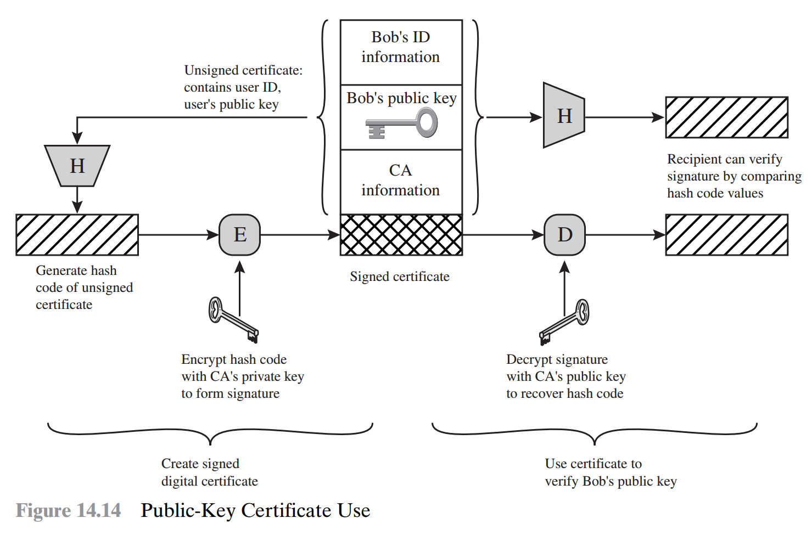
X.509
X.509 is a framework for the provision of authentication services
Public key and associated data is signed with CA’s private key after hash function
User can verify the certificate by comparing Hashed result and Decrypted signature

Slide 25
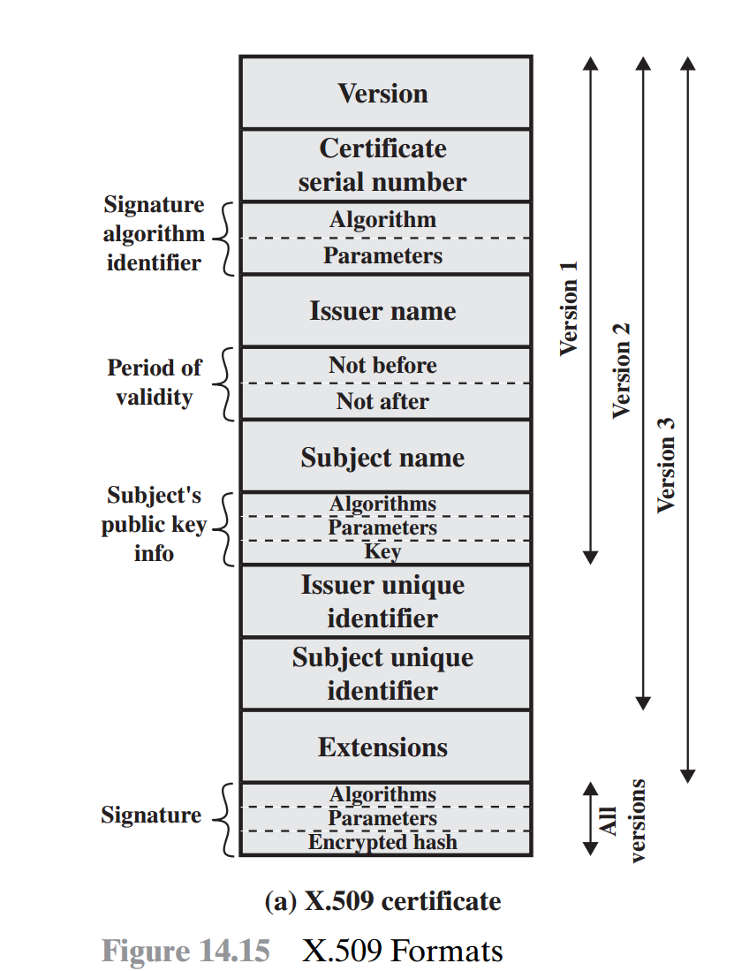
The Structure of Certificates #1
Certificate serial number
Unique integer value of certificate
Signature algorithm identifier
The algorithm used to sign
Issuer name
Name of the CA created and signed certificate
Period of validity
The valid date
Subject name
The name of the owner of the public key

Slide 26
The Structure of Certificates #2
Public key information
Public key and algorithm
Issuer/Subject unique identifier
Incase same X.500 name has been used
Extensions
Represent additional data
Signature
Covers all of other fields of the certificate
Indicates algorithm used to sign

Slide 27
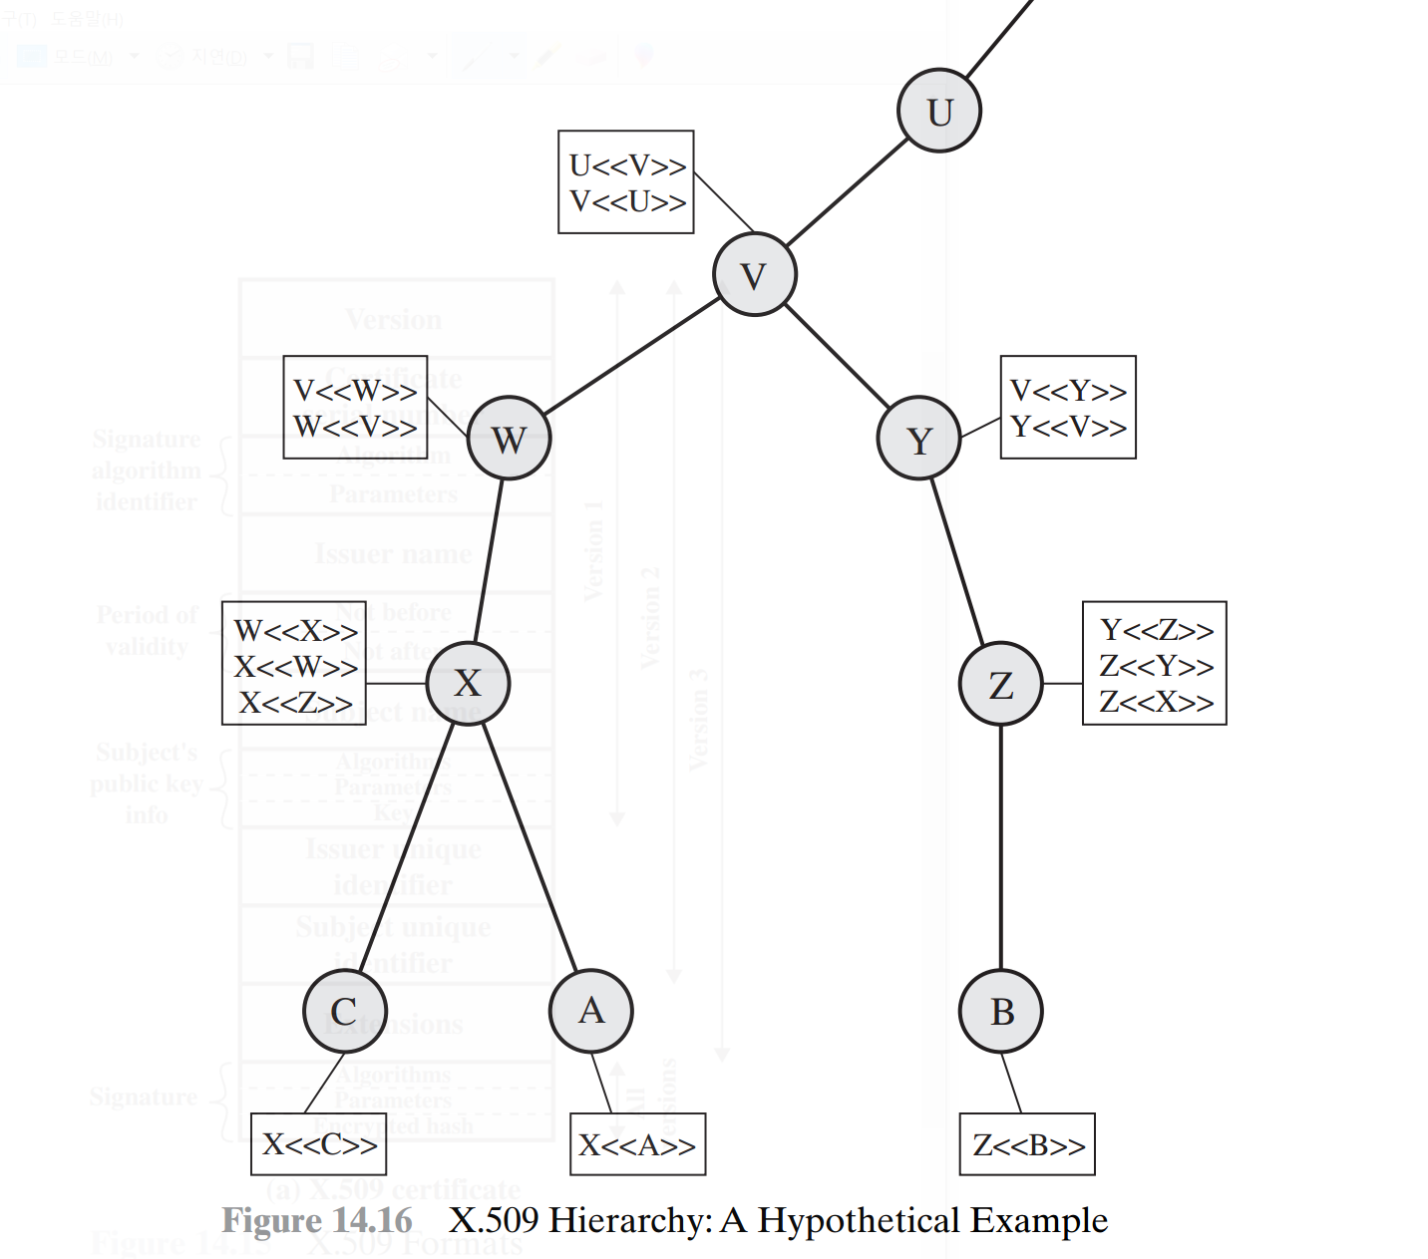
Certificate Chain
A number of CAs securely provides public key to some fraction of the users
CAs are arranged in a hierarchy
A can obtain B’s public key with only public key X by following certificate chain

Slide 28
Certificate Revocation List
Each CA must maintain a list consisting of all revoked but not expired certificates
CRL is signed by the issuer
When a user receives a certificate, the user must check CRL
Could maintain a local cache of CRL

Slide 29
X.509 Version 3
Version 3 has an optional extension which convey additional information that recent design has shown to be needed
Key and policy information
Additional information about keys and policy
Certificate subject and issuer attributes
Additional information about certain subject and issuer
E.g., postal address, picture image
Certification path constraints
Constraint of the certificate of CA issued by other CA
E.g., Restrict the usage of certificate in certificate chain

Slide 30
14.5 Public key infrastructure

Slide 31
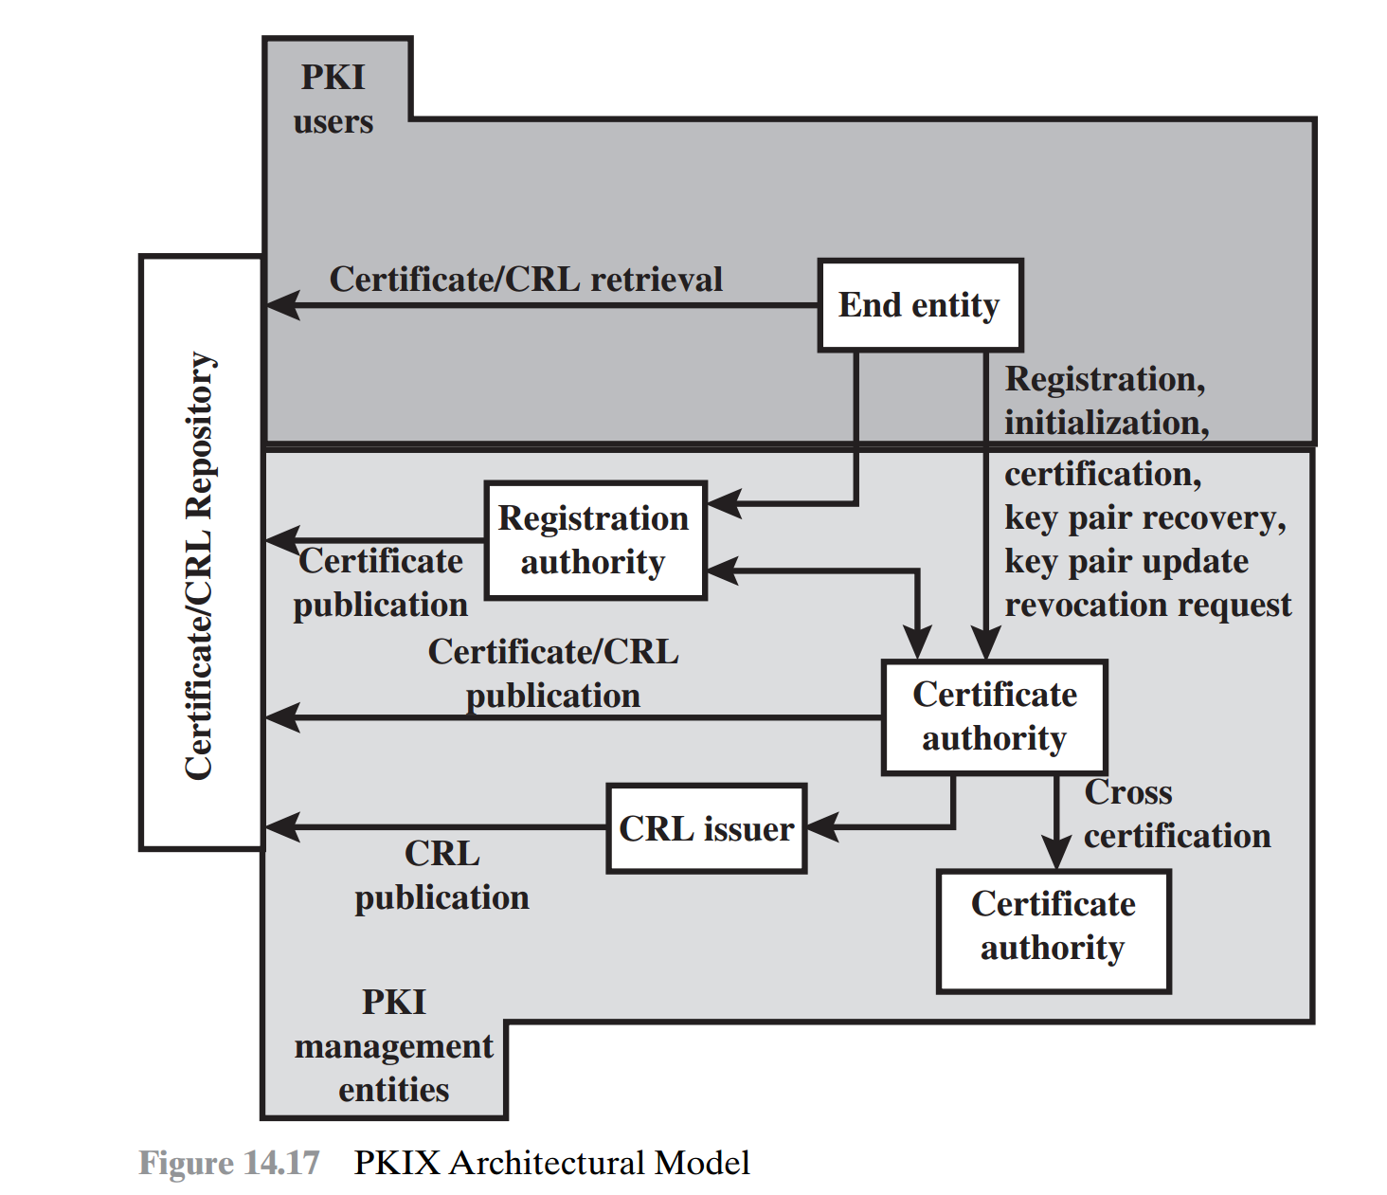
Elements
PKI is infrastructure to enable secure acquisition of public keys
End entity
End users
CA
Issuer of certificates
RA
Optional component of CA for administrative functions
CRL issuer
Repository
Any method for storing certificates and CRLs

Slide 32
Management Functions
Registration
User enroll his entity in a PKI
Initialization
Securely initialize public key
Certification
CA issues certificate
Key pair recovery/update
E.g., recover forgotten password
Revocation request
Cross certification
CA signed issued CA’s certificate

Slide 33
Conclusion
Overview the key distribution using symmetric encryption
Overview the key distribution using asymmetric encryption
Examine the many ways of distribution of public keys
X.509 certificates
PKI

